Slide 1
#ACPSCAI15
Designing Student-Centered Learning Experiences

Slide 2
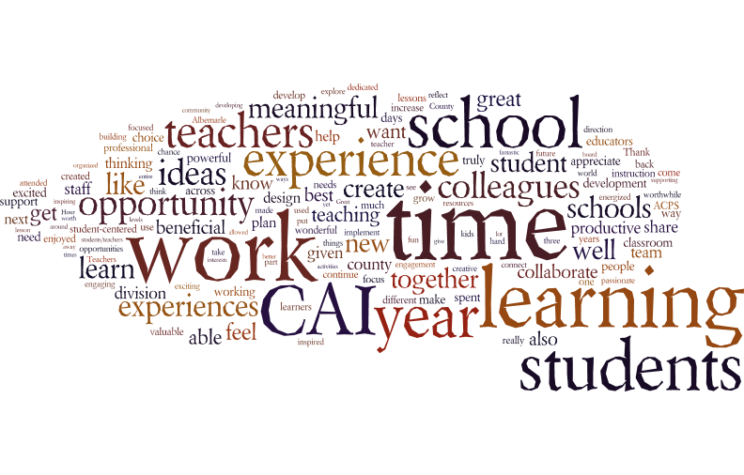

Slide 3
What was the focus?
How can we design learning experiences for our students that encourage their growth in lifelong learner competencies?

Slide 4
How does this connect to the work of our division?
“To create meaningful innovations, you need to know your users
and care about their lives.”
Notes:
Empathy for students

Slide 5
Who came together to collaborate?
179 Teachers and Instructional Coaches
43 Administrators
19 Central Staff

Slide 6
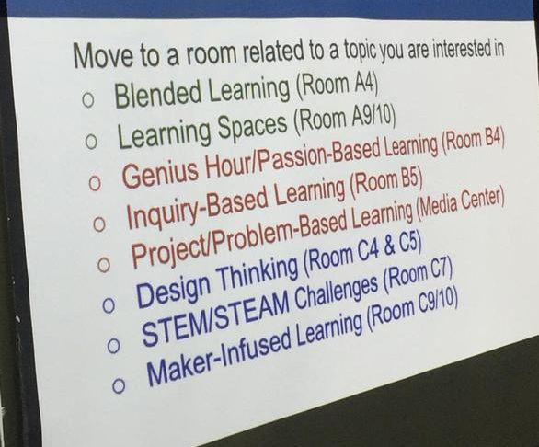
What was the process?
Explore Innovations
Form Design Teams
Design Learning Experiences
Get/Give Feedback
Share with School Team
Commit to Next Steps

Slide 7
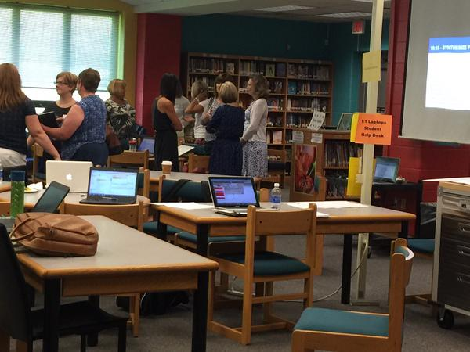
What was the process?
Explore Innovations
Form Design Teams (45)
Design Learning Experiences
Get/Give Feedback
Share with School Team
Commit to Next Steps

Slide 8
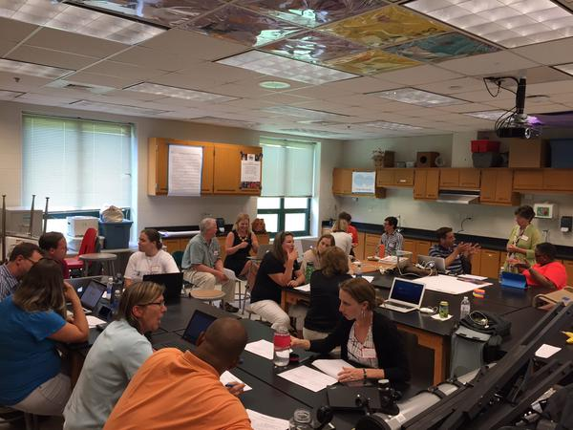
What was the process?
Explore Innovations
Form Design Teams (45)
Design Learning Experiences
Get/Give Feedback
Share with School Team
Commit to Next Steps

Slide 9
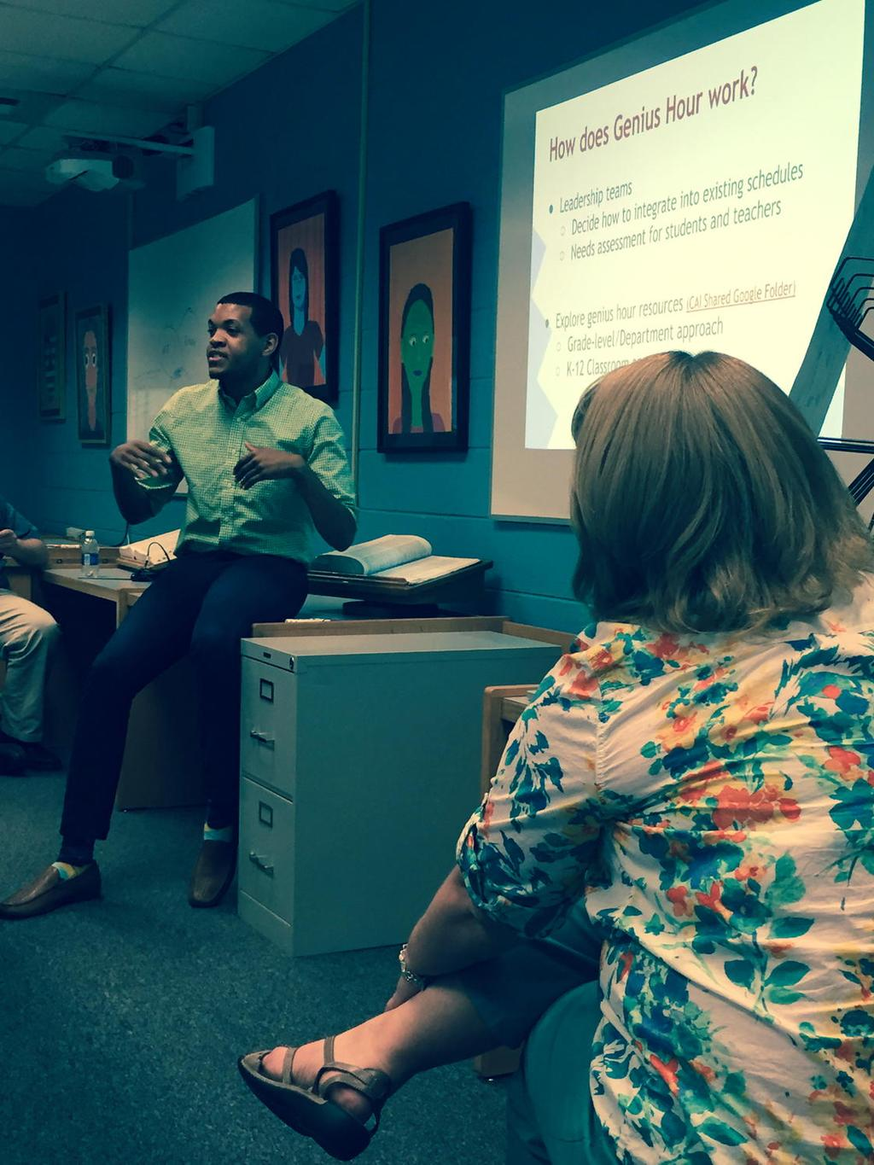
What was the process?
Explore Innovations
Form Design Teams (45)
Design Learning Experiences
Get/Give Feedback
Share with School Team
Commit to Next Steps

Slide 10
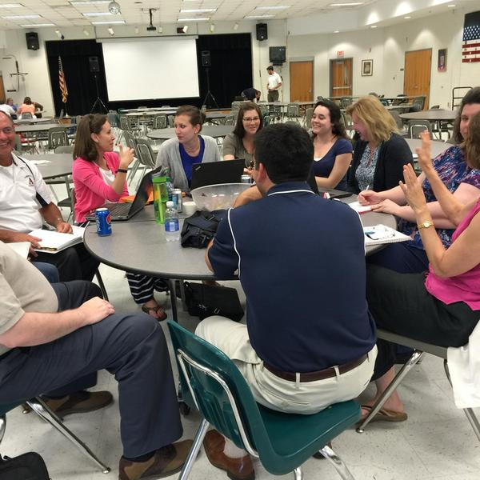
What was the process?
Explore Innovations
Form Design Teams (45)
Design Learning Experiences
Get/Give Feedback
Share with School Team
Commit to Next Steps

Slide 11
What was the process?
Explore Innovations
Form Design Teams (45)
Design Learning Experiences
Get/Give Feedback
Share with School Team
Commit to Next Steps
I will intentionally focus on making student learning more student-driven.
I am really excited to implement Genius Hour in my classroom. I have many curious students, and I can't wait to give them time specifically to investigate what they are interested in learning.
I will be enthusiastically creating new and exciting experiences for my students to help them develop the "soft skills" they will need for success throughout their lives.
I would explain that I worked with colleagues to develop a multi-disciplinary lesson about WWI using an inquiry-based learning approach.

Slide 12
What are our next steps?
July Professional Learning Sessions
Making Connections
Start Thinking about CAI 2016

